Slide 1
Course - DT228-2
Module (Subject) -
Human Computer Interaction
Semester 2, Week 5
PROTOTYPING
(for Interface Design)

Slide 2
Overview of Lecture
Life-Cycle Models in Human Computer Interfaces
Four basic activities in HCI
Requirements
Design
Develop/Build
Evaluation

Slide 3
Design Model
Requirements
Design
Build/Develop
Prototyping
Evaluate
Life-Cycle Models

Slide 4
Interaction Design
Interactive products in everyday use support people in their everyday and working lives. Examples;
mobile phones, computers, ATMs, washing machines, smart televisions...
Are they easy, effortless and enjoyable to use?
Prototyping

Slide 5
Interaction Design (2)
Interaction design involves taking into account a number of interdependent factors, including context of use, type of task and the type or kind of user.
As a designer, you need to strive for usability and establish user experience goals.
Prototyping

Slide 6
Conceptual Model
The DESIGNER has
model of how the system
should work.
The USER creates a model of how
he/she thinks the system works.
The SYSTEM has an image of how
it actually works.
In an ideal world, all three should map into each other and the user’s mental model of the system should be equal to the designer’s mental model. That would provide good usability and effective interaction.
DESIGN
MODEL
USER’S
MODEL
DESIGNER
USER
SYSTEM
SYSTEM
IMAGE
Prototyping

Slide 7
The Interaction Design Process
Identify needs/establish requirements
(Re) Design
Evaluate
Build an interactive version
Final product
Good for PROTOTYPING!
Notes:
This is a simple model for how the process of interaction designing looks like. The main thing is that it is a iterative process.
First gather data about needs, users, requirements and so on.
Then Design, then build a interactive version of the design ideas to try it. Evaluate and make further design proposals and get more data.
Iterate! Iterate! Iterate!

Slide 8
Prototypes
In other design fields a prototype is a small-scale model:
a miniature car
a miniature building or town
Prototyping

Slide 9
Prototypes (2)
“Users can’t tell you what they want, but when they see something and use it, they soon know what they don’t want” (Preece)
A prototype is an invaluable design tool for testing ideas, clarifying requirements and initiating user input and feedback.
Prototyping is a core component of iterative design of information systems.
Prototyping

Slide 10
What is a Prototype?
In HCI design it can be (among other things):
a series of screen sketches
a storyboard, i.e. a cartoon-like series of scenes
a PowerPoint slide show
a video simulating the use of a system
a lump of wood (e.g. PalmPilot – Google ‘PalmPilot wooden model’)
a cardboard mock-up
a piece of software with limited functionality, written in the target software language or in another language
Prototyping

Slide 11
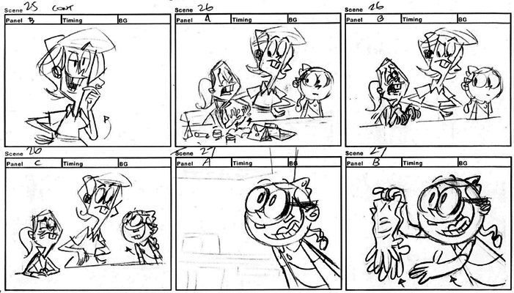
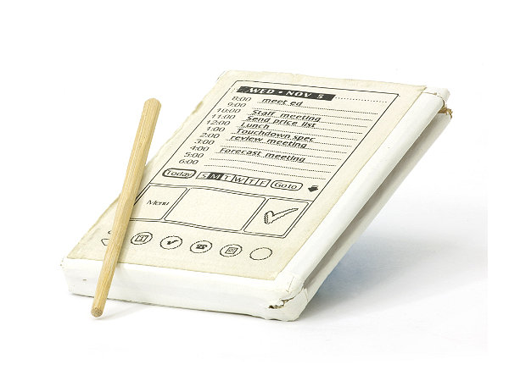
What is a Prototype? (2)
Storyboard example, and wooden PalmPilot
Prototyping

Slide 12
Why Prototype?
Evaluation and feedback are central to interaction design – especially when they are quick. Also;
Team members can communicate effectively
Prototypes answer questions, and support designers in choosing between alternatives
Prototyping

Slide 13
Why Prototype? (2)
Prototypes exists for some purpose. For example;
to show a “concept” to some stakeholders
to get feedback about some aspect of a product or project
test some part of the product or project
E.g. an aircraft wing in a wind-tunnel
Prototyping

Slide 14
Why Prototype? (3)
Evaluation and feedback are central to interaction design.
Developers can test feasibility of ideas with teams or users.
Stakeholders can see, hold and interact with a prototype more easily than a document or a drawing.
Team members and users can communicate effectively.
To validate existing / other requirements.
It encourages reflection: a very important aspect of design
Prototypes answer questions, and support designers in choosing between alternatives.
Prototyping

Slide 15
Why Prototype? (4)
“To get a a good idea, get lots of ideas.”
The problem with going straight to high-fidelity prototyping:
too easy to focus on ‘fit and finish’
developers resist changing software
the software prototype sets expectations
bugs in software prototypes compromises an evaluation
Prototyping

Slide 16
What to Prototype
Prototyping reduces uncertainty
It can be a major tool for risk management
Apply it to whatever you might be uncertain about!
Prototyping technical issues
E.g. run-time issues
Prototyping to establish requirements
Users “see” functionality
Prototyping for usability concerns
Our concern in this module!
Prototyping

Slide 17
What to Prototype (2)
Technical issues
Work flow, task design
Screen layouts and information display
Difficult, controversial or critical areas of systems design
Prototyping

Slide 18
When to Prototype
For software, you might prototype at various times in the lifecycle.
There may be different goals, you may be using different techniques.
During:
Conceptual Design
Interaction Design
Screen Design
Prototyping

Slide 19
Prototyping Goals
While a usable product is a system where its image provides a mental model for the user, which is equal to the designers mental model, it is natural to compare these models.
That can be done using prototyping.
Depending on the product that is being developed, the designer should create, firstly, a brief idea of what kind of feedback is desired from the prototyping process.
Prototyping

Slide 20
Conceptual Design
Early in development
Explore high-level issues
Different conceptual models
Interaction styles
User needs and characteristics
Usability goals
High-level representations
Far from final code or GUIs
Prototyping

Slide 21
Interaction Design
Later in development
Focus on user work-flows
Tasks and scenarios you’ve identified
Might focus at the screen (or page) level. Possibly like this:
identify screens, pages, activities
Organise these into groups
Define flows or transitions between them
Involve users in the evaluation
Representations
Still probably not much like final code or GUIs
Prototyping

Slide 22
Screen Design
Before development
Define and refine screens (pages)
Blue-prints for final physical design
User evaluation
Both achieving tasks and navigation, and other usability criteria (as we’ve studied)
Representations
Low-fidelity or high-fidelity prototypes
Prototyping

Slide 23
Types of Prototype
‘Fidelity’ refers to the level of detail, and how much the prototype matches the finished article:
Low Fidelity
Medium Fidelity
High Fidelity
Prototyping

Slide 24
Low Fidelity Prototypes
‘Low fidelity’ uses a medium which is unlike the final medium, e.g. paper, cardboard
It is quick, cheap and easily changed
Examples: Sketches of screens, task sequences, etc ‘Post-it’ notes Storyboards ‘Wizard-of-Oz’
Prototyping

Slide 25
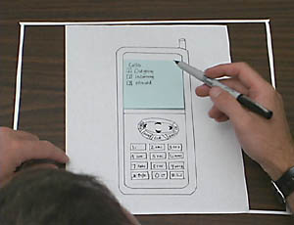
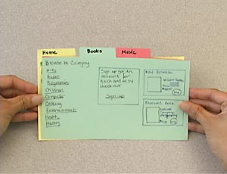
Low Fidelity Prototypes (2)
A low fidelity prototype does not look very much like the final product. Material, behaviour etc.
Using materials such as paper and cardboard, rather than electronic screens, complex models and detailed code.
Simple, quick and cheap to produce and redesign. Encourages further exploration of alternative designs and ideas.
Happens at an early stage of development – prototyping for the conceptual design.
Prototyping

Slide 26
storyboards
Storyboards are often used with scenarios, bringing more detail of the design
It is a series of sketches showing how a user might progress through a task using the device
Used early in the design process
Prototyping

Slide 27
storyboards (2)
Storyboards are:
a low fidelity visual representation where
steps or actions represented by panels, like a comic book
Goals are to
flesh out the scenarios in an interaction design
effectively communicate with users or stakeholders
Prototyping

Slide 28
storyboards (3)
Storyboards should be ‘real’ and ‘representational’ rather than ‘abstract’ or ‘complete’.
Used in different ways at different phases
Early: focus on user tasks, work-flow, context, etc.
Later: low-fidelity drawing of screens, menus, etc.
Principles:
Describe a scenario - focused on interaction
Contains explanations, notes, etc.
Prototyping

Slide 29
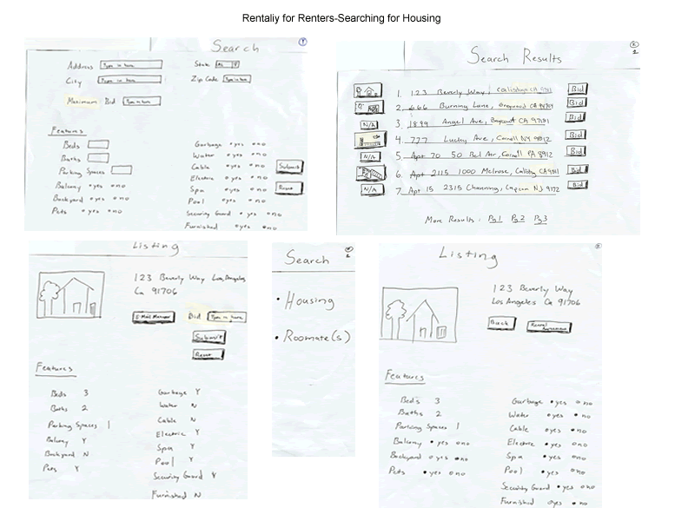
storyboards (4)
Prototyping

Slide 30
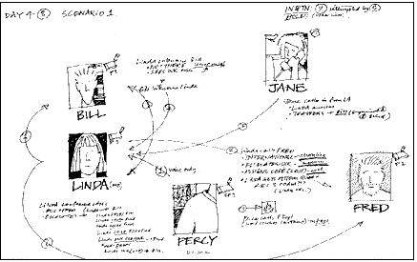
EXAMPLE: This shows high-level of view of users involved in other storyboards
From: Usability Case Studies, http://ucs.ist.psu.edu

Slide 31
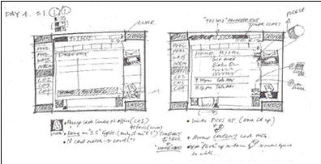
EXAMPLE: Low-fidelity interface sketches
Annotated with scenario/execution info
From: Usability Case Studies, http://ucs.ist.psu.edu

Slide 32
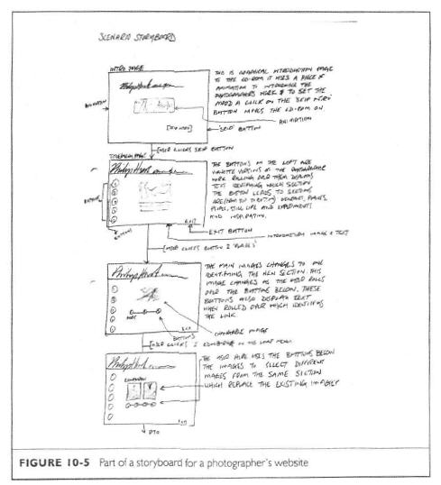
EXAMPLE:
Storyboard for a website for photographers
Sequence of pages based on clicks
Explanations / annotations
From book: Designing Interactive Systems, 2005

Slide 33
sketching
Sketching is important to low-fidelity prototyping.
You need not be inhibited about your drawing ability. Practice simple symbols. Draw stick men/women and boxes if necessary.
You can use post-it notes, photo-copied widgets, etc…
Prototyping

Slide 34
Using Office Supplies
Index cards, Post-It Notes, paper sheets…
Index cards (EG 10 X 15 cms)
Each card to represent one screen
These are often used in website development
Prototyping

Slide 35
Using Office Supplies (2)
Index cards, Post-It Notes
Can represent one page, or one screen
Can be colour coded
Draw on them,
Group them,
Put them on a wall or whiteboard, connect them with string or lines
Use ‘write-on’ tape, clear film, etc
Prototyping

Slide 36
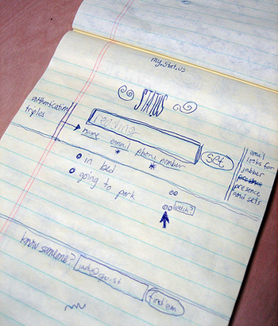
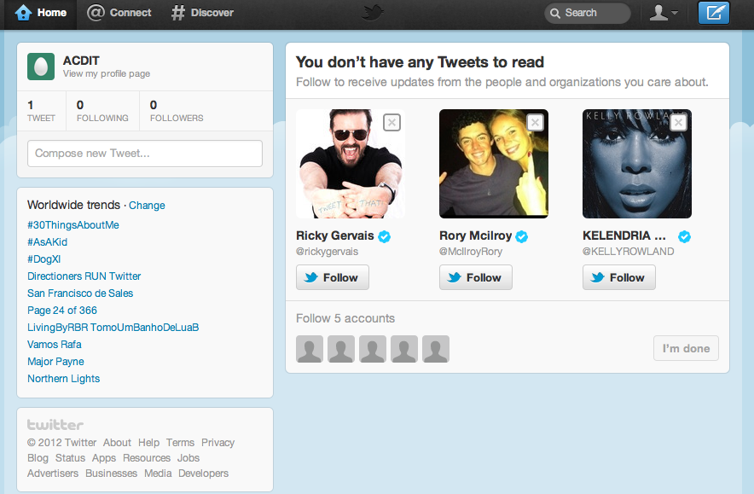
The original Twitter Prototype
Prototyping

Slide 37
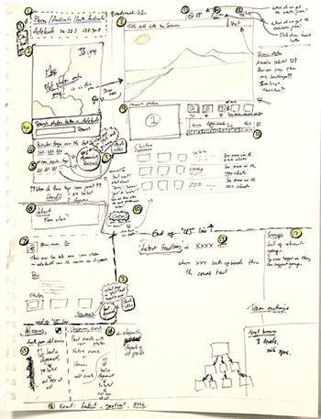
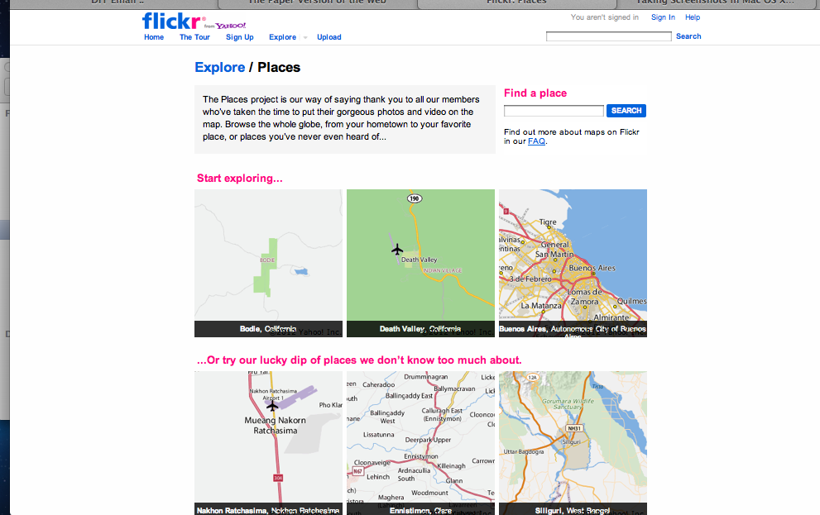
The original FlickrPlaces Prototype
Prototyping

Slide 38
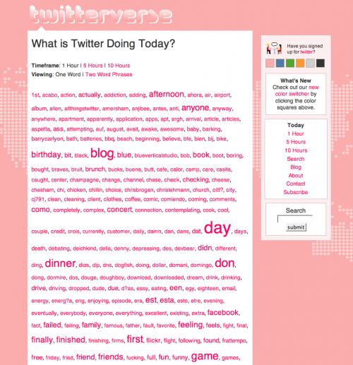
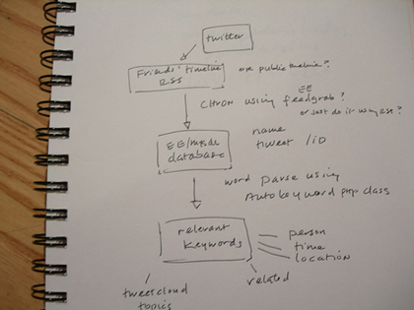
The original Twitterverse Prototype
Prototyping

Slide 39
Wizard of Oz Prototyping
With this, the user thinks they are interacting with a computer, but a developer is responding to output rather than the system.
Usually done early in design to understand users’ expectations
User
Wizard
>Blurb blurb
>Do this
>Why?
Prototyping

Slide 40
Medium Fidelity Prototypes
Prototyping with a computer
Simulating some, but not all, features of the interface.
This can be engaging for end users.
Purpose
Provides sophisticated, but limited, scenarios for the user to try.
You can test more subtle design issues.
Dangers
Users’ reactions are often “in the small”.
Users often reluctant to challenge the designer.
Users often reluctant to touch the design.
Management may think it is real!
Prototyping

Slide 41
High Fidelity Prototypes
‘High fidelity’ uses materials that you would expect to be in the final product.
The prototype looks more like the final system than a low-fidelity version.
Danger - that users think they have a full system...
Prototyping

Slide 42
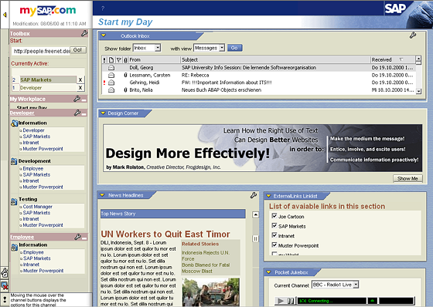
High Fidelity Prototypes (2)
Looks very much like the final product.
If the prototype is for software system, a software tool, such as Macromedia Director or Flash, Visual Basic or Smalltalk, might be needed.
Software prototype
tools are also often
qualified development
environments.
More time-consuming to
produce than low-fidelity
prototyping.
Prototyping

Slide 43
High Fidelity Prototypes (2)
Benefits of high-fidelity prototypes
The most realistic prototype
Closer to final product
- So good for developers and users
You can collect metrics at this point
Limitations
More expensive, less rapid than low or medium fidelity prototypes
Reluctance to change when prepared
Prototyping

Slide 44
Horizontal versus vertical Prototyping
Two common types of compromise:
Horizontal prototype – shows a user interface, but has limited functionality behind the buttons/controls. No database links included.
Vertical prototype – contains all of the high level and low level functionality of particular areas in the system.
Prototyping

Slide 45
Prototyping Methods
Requirements Animation – functional requirements are demonstrated in a s/w prototype
Throw-away prototyping– similar to requirements animation... and prototype is not developed into the final product
Evolutionary prototyping – prototype is not discarded and is used as the basis for the next iteration of design. I.e. system “evolves” from prototype
Incremental prototyping – final product is built as separate components, one at a time – allows large systems to be installed in phases to avoid delays between specification and delay
Prototyping

Slide 46
Prototype Method
Description
Useful Tool
Requirements Animation
Allows possible requirements to be demonstrated in a prototype which can then be assessed by users
Screen painters are suitable for animating the representational aspects. Data manipulation and other high-level languages are suitable for animating the functional aspects. Authoring languages, menu builders and active images tools prototype operational aspects
Rapid (throw-it-away) Prototyping
Aims to collect information on requirements and the adequacy of possible designs. Recognises that requirements are likely to be inaccurate when first specified. the emphasis is on evaluating the prototype before discarding it in favour of some other implementation
Representational requirements and designs can be quickly created using screen painters, forms systems, report generators and menu systems. Hypermedia and VHLL systems are also particularly suitable
Evolutionary Prototyping
compromise between production and prototyping. The system can cope with change during and after development. Helps overcome the traditional gap between specification and implementation
It is important to prototype using the facilities that will eventually be used to implement the final system. Additions and amendments are made to the model following evaluation and the system is regenerated
Incremental Prototyping
the system is built incrementally, one section at a time. Incremental prototyping is based on one over all design.
Re-usable software and highly modular languages can be useful as more pieces are ‘bolted on’ to gradually produce the final system.

Slide 47
Prototyping and Design
Prototyping is useful at different stages of design:
Task Level
Product
Conceptualisation
Screen Design
Prototyping

Slide 48
Prototyping software Tools
You need to choose the right software tools for the prototype:
What prototyping method? - will the prototype be thrown away? Evolutionary? Etc.
What is the purpose?
- product conceptualisation? Screen design?
Who will be developing it?
- how much programming skill is required?
Prototyping

Slide 49
Prototyping software Tools (2)
Prototyping
Tools
Specifically used for prototyping
Production Tools
(that can be used
for prototyping too)
Prototyping

Slide 50
Prototyping software Tools (3)
Production tools:
produce re-usable software
The constraints of producing quality software are not necessarily compatible with prototyping
The code management overhead can slow production
may cause higher costs of producing the prototype
The methods (tools) require development skills
Prototyping

Slide 51
Prototyping software Tools (4)
Prototyping specific tools:
are faster
can be used by non-technical staff
must be ‘throw-away’
may not look exactly like future system
may limit what can be configured
Prototyping

Slide 52


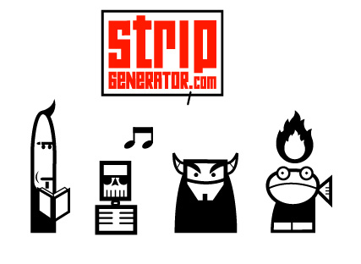

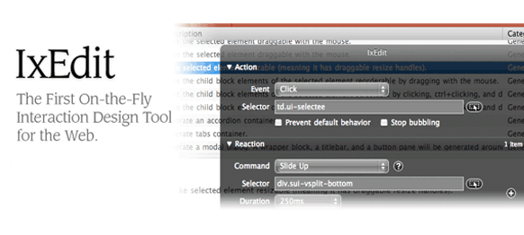
Prototyping specific Tools
Prototyping

Slide 53
Compromises in Prototypes
All prototypes involve compromises.
For software-based prototyping there may be: slow response, sketchy icons, limited functionality, and many other possibilities…
Two common types of compromise:
‘horizontal’: provide a wide range of functions, but with little detail.
‘vertical’: provide a lot of detail for only a few functions.
Compromises in prototypes must not be ignored. Products need to be engineered.
Prototyping

Slide 54
Possible problems in Prototyping
Examples:
Pressure to enhance prototype to become delivered system
From the client
From management
When these people see code, see an almost-working “system”
Why not use the prototype?
Prototypes are built for quick updates, so...
No real design, therefore hard to maintain
Code can be unstructured, no error checking
The prototype may be in the ‘wrong environment’
Prototyping

Slide 55
Constructing from Prototypes
Construction: taking the prototypes (or learning from them) and creating a final product.
Quality must be attended to: usability (of course), reliability, robustness, maintainability, integrity, portability, efficiency, etc
The product must be engineered through;
Evolutionary prototyping
‘Throw-away’ prototyping
Prototyping

Slide 56
Advantages and Disadvantages of Low Fidelity Prototypes
Advantages Disadvantages
Low-fidelity representations, such as sketches, differ from the final product in interaction design, visual appearance, and/or level of details. The method is quick and cheap, which encourages iterative design idea tryouts between/during usability tests.
Quick low-fidelity tests allow designers and users to focus on high-level interaction design and information architecture, rather than on details or visual style.
Users might judge a low-fidelity prototype as unprofessional.
While low-fidelity prototypes allow spontaneous changes for exploring interactions, they also sacrifice some realism.
Limitations in navigation and flow while a control person has to ‘make the interaction’.
Prototyping

Slide 57
Advantages and Disadvantages of High Fidelity Prototypes
Advantages Disadvantages
High-fidelity prototypes offer more realistic interactions than low-fidelity.
Better at conveying the range of design possibilities.
User-driven.
High-fidelity prototyping may make designers reluctant to change designs and less likely to fully explore the design space.
They take a long to build and requires skill.
Reviewers and testers tend to comment on surface aspects rather than content.
Prototyping

Slide 58
Design Model
Requirements
Design
Build/Develop
Evaluate
Evaluation Paradigms
Life-Cycle Models

Slide 59
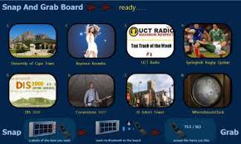
Consider This…
Interactive Noticeboard
Pinterest… (?)
Evaluation Issues

Slide 60
Consider This… (2)
Interactive Noticeboard:
Think of two ways which you can evaluate a prototype …
MORE on Evaluation later in the semester…
Evaluation Issues

Slide 61
Summary of the Lecture
HCI Design Models
Requirements
Design (a quick mention, based on last week)
User-centred design
Develop/Build
Prototyping
Why, how…
Low fidelity prototyping (medium fidelity, very briefly)
High fidelity prototyping
A quick, introductory mention of Evaluation

Slide 62
References
Preece, J. et al. (2002) Interaction Design
Shneiderman, B. & Plaisant, C. (2005) Designing the User Interface
Benyon, D. et al (2005) Designing Interactive Systems
Helander, M. et al (1997) Handbook of Human-Computer Interaction
Hartson, R. & Hix, D. (1989) Towards Empirically Derived Methodologies and Tools for HCI Development
Mayhew, D. (1995) The Usability Engineering Lifecycle
Alan Dix et al (1993) Human Computer Interaction
References

